Slide 1
Facial Emotion Detection using CNNs
By Kota Shashidhar - 2020AAPS0369H
Tarun Rajkumar - 2020A8PS1447H
Thathapudi Sanjeev Paul Joel - 2020AAPS0120H

Slide 2
PROJECT OUTLINE

Slide 3
INTRODUCTION
In the modern world, where every sector is becoming automated through the power of AI and ML, emotion recognition is no exception. It can be incorporated directly into a number of applications mostly in the health sector like: health monitoring of patients, interpreting expressions of autism patients, etc.
Meanwhile, emotion recognition is used indirectly in a multitude of applications like:
Adjustment of learning techniques based on real-time emotions displayed.
An alert system for detecting driver fatigue, and so on.

Slide 4
OBJECTIVES
Build and Test CNN Classifier Models for Facial Image Dataset
Train the CNN model and extract features
Test and predict emotions on example facial images

Slide 5
ACTIVITIES BEFORE
MID - SEM:
Learnt about the basic architectural elements of a Convolutional Neural Network (CNN)
Researched on their importance and applications in various fields
Built custom & transfer learning models for detecting facial emotions and compared their performance

Slide 6
Learning Outcome
Understanding the methodology and math behind a Neural Network
Using Python to build, train and test CNN models
Understand how CNN is used for image classification

Slide 7
MATHEMATICS AND METHODOLOGY

Slide 8
Methodology
Phase 1: Literature Review
Phase 2: Collection, Preprocessing, & Visualization of Image Data
Phase 3: Building CNN Custom and Transfer Learning Classifier Models
Phase 4: Using the model saved to predict the emotion of few sample images

Slide 9
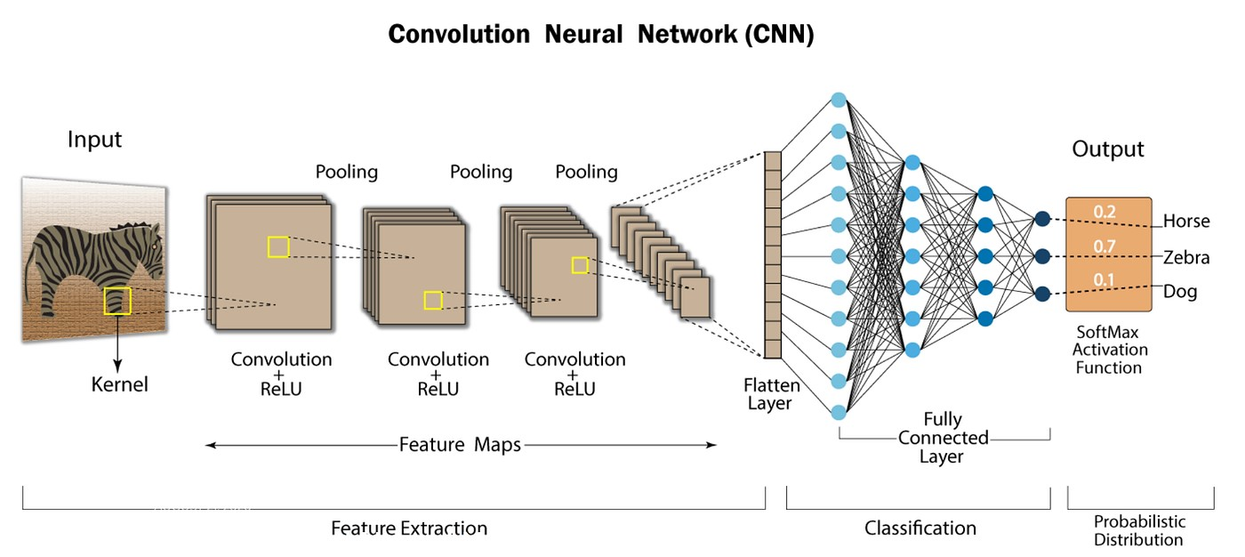
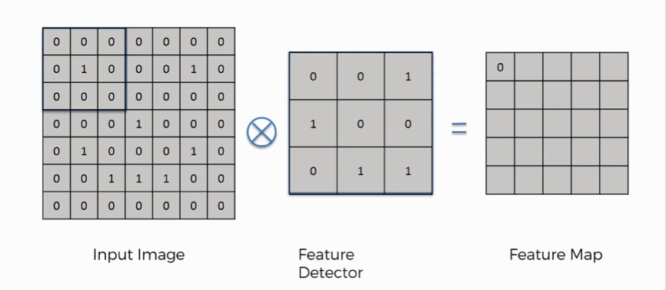
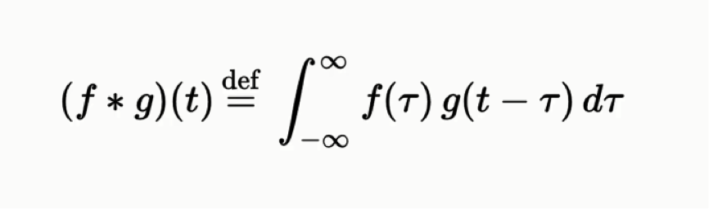
Convolutional Neural Networks
Convolutional Neural Networks(CNN) are well suited for application which use spatial data such as images.
It is divided into three layers-the convolution layer, the pooling layer and the fully connected layer.
https://www.linkedin.com/pulse/what-convolutional-neural-network-cnn-deep-learning-nafiz-shahriar
Convolution Operation

Slide 10
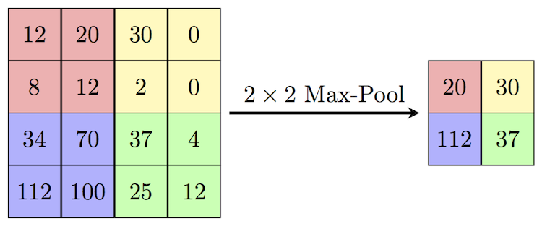
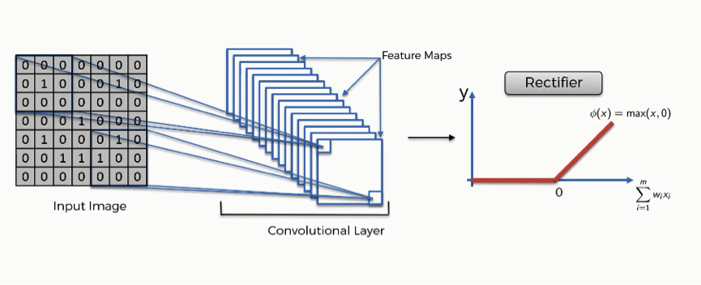
Convolutional Neural Networks
An activation function, like ReLU is used, to process the output from the convolution layer. This function introduces non-linearity to the model, enabling it to acquire more intricate representations of the input data.
The pooling layer is used to reduce the dimension of the feature maps generated by the convolution layer to minimize the computation required and extract the most prominent feature from the feature map.
The fully connected layer is basically a simple ANN that may be used to either predict a value (regression) or give a linguistic label (classification) using the input image.
This layer's role is to combine the features acquired through the convolutional and pooling layers in order to make predictions.

Slide 11
LSTM Networks are a commonly used variation of Recurrent neural networks(RNN).
They are used to make predictions based on sequential data

Slide 12
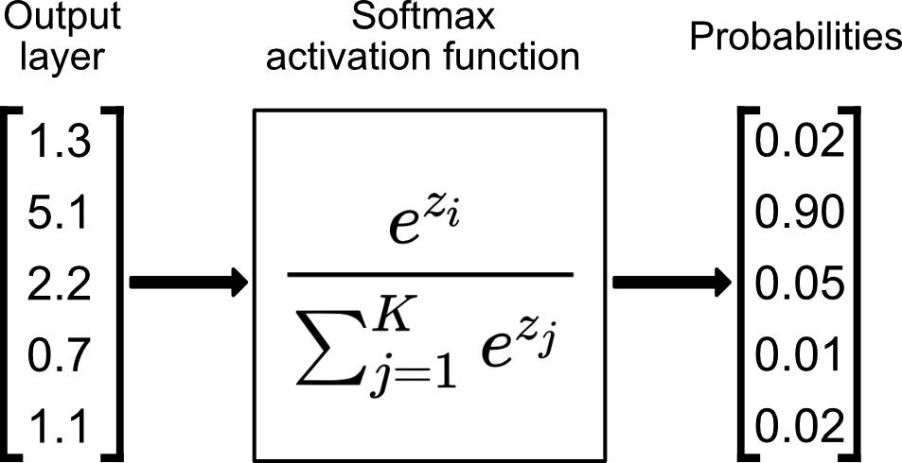
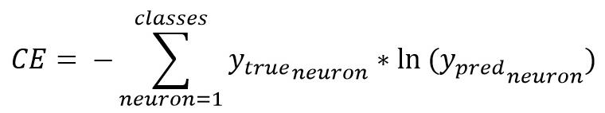
Mathematics Involved
Softmax function: This activation function is particularly useful in multiclass classification problem, where we have to ensure that the sum of probabilities equals ‘1’.
Sparse Categorical Cross-entropy: This function uses the true class indices to evaluate the loss and doesn’t necessarily have to be one-hot encoded.

Slide 13
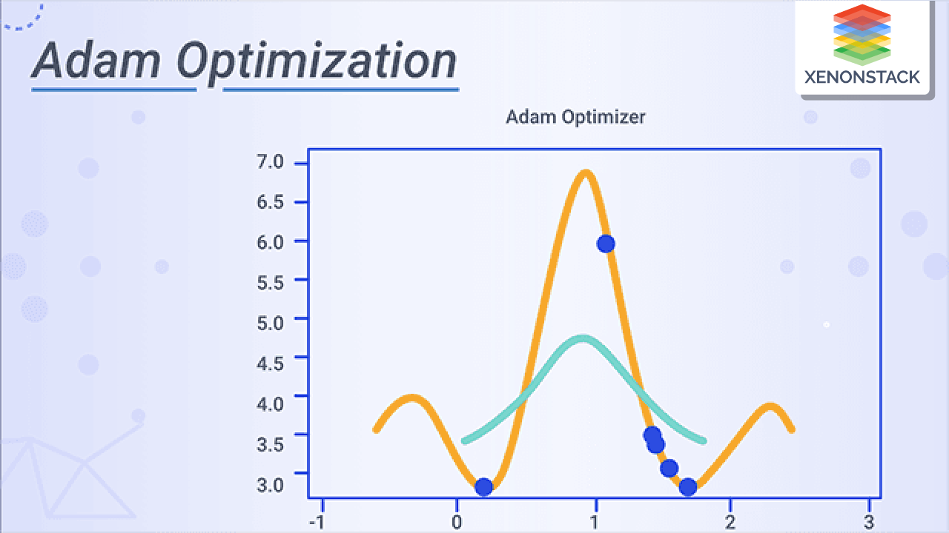
Mathematics Involved
Adam Optimizer: Based on SGD, Adam employs adaptive learning rate to improve the convergence speed and training accuracy.
The idea behind the Adam optimizer is adjusting the learning rate adaptively for each parameter in the model based on the history of gradients calculated for that parameter.

Slide 14
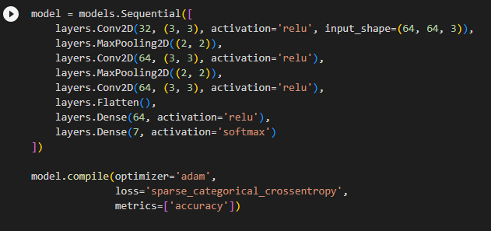
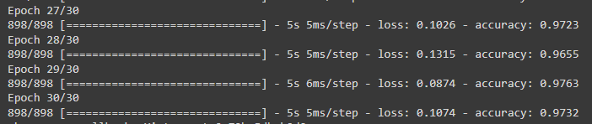
CNN Model Specs
The CNN model uses 3x3 filters with a pooling of 2x2 size.
Activation functions for the convolutional layers are all relu activation functions. A relu function is basically a ramp function only for positive values and returns 0 if the input is negative.
Last layer is a dense layer that has 7 neurons because we have 7 classes we would like to classify the images into
‘adam’ optimizer is used so that it is automatically adapted during training.
This snippet showcases the training accuracy of the model at 27-30 epochs. It can be observed that as loss decreases, the accuracy increases and finally accuracy settles at 97.32%.

Slide 15
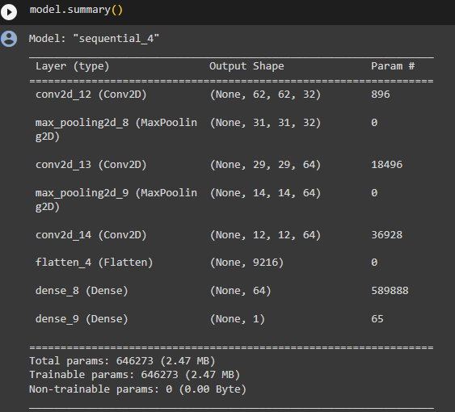
CNN Model Specs
This summary shows the size of each layer in the CNN.
For example, look at the change in size after the 2nd convolution layer and the shape after 2nd pooling layer. It essentially translates to the number of neurons and number of inputs to them.

Slide 16
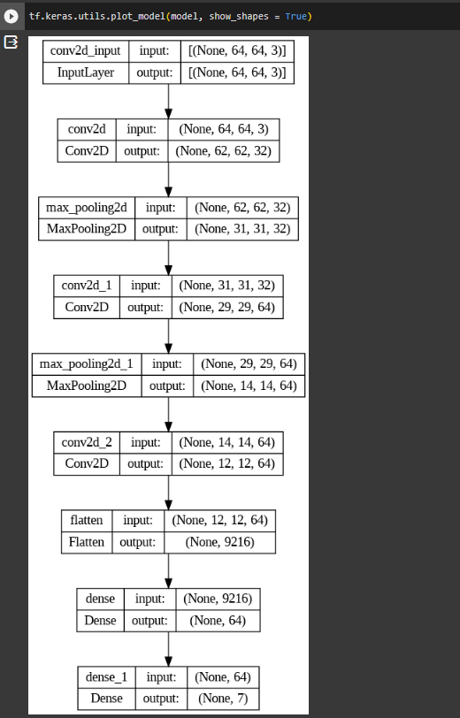
Custom CNN Model architecture
This is a visual representation of the CNN architecture. From here, we can clearly see the way the model takes a 64x64 color image and then finally gives us a estimated likelihood of the each emotion and that is why we have 7 output neurons at the last dense layers.

Slide 17
RESULTS AND INFERENCES

Slide 18

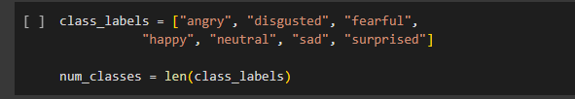
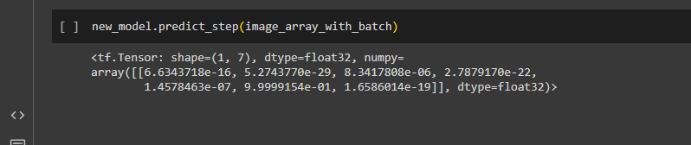
Results of Testing an Image
List of Classes Used
Image representing a sad person
CNN Output representing a sad person

Slide 19
INFERENCES
We found that the transfer learning model involves more computational burden as compared to the custom model.
Implementing the CNN to classify facial images and extract features was very efficient (97% accuracy)

Slide 20
FUTURE SCOPE
Use fuzzy c-means clustering to divide the emotions in terms of the similarity in features
Hybridize the CNN Classifier Model with an LSTM for better performance
Use a fuzzy inference system to predict the outcome to be taken in emotion detection based applications

Slide 21


